Slide 1
Software Project
TEDx NIITUNIVERSITY
By- Ankit Pahuja
Ayush Dosajh
Chinmaya Kr. Bansal

Slide 2
Background info
For the first time, NU is to hold a Tedx Event.
Licensee: Akshaye Khanna
Mentor: Prof Arghya

Slide 3
TEDx
TEDx was created in the spirit of TED's mission, "ideas worth spreading." It supports independent organizers who want to create a TED-like event in their own community.

Slide 4
TEDx in NIITUniversity
The Precipice!
Precipice - a small word which holds multiple meanings in different spheres of our life. For mountaineers, it's the place from where they can taste the success of their hard work as they enjoy the world stretching itself towards the horizon. For an entrepreneur, it may mean a benchmark the he/she needs to cross to set new records. For lawmakers, it may mean a gap between two ethnic groups which needs to be filled up by creating a feeling of communal harmony.

Slide 5
MISSION
The mission of this project is to bring TEDx ideology in this University and to make this initiative a success so that it could be continued in the future.

Slide 6
ABOUT PRODUCT
The products are all made with keeping client in mind. The products are made to be easy to use, edit and maintain.

Slide 7
Website
This page has links to all the other components of the project . Also it serves as an information page.
Link - https://tedxniituniversity.com/

Slide 8
BLOG
All the articles /updates related to the event are uploaded here . It also has a twitter feed , counts the blog hits and is easy to use and maintain.
Link- https://blog.tedxniituniversity.com/

Slide 9
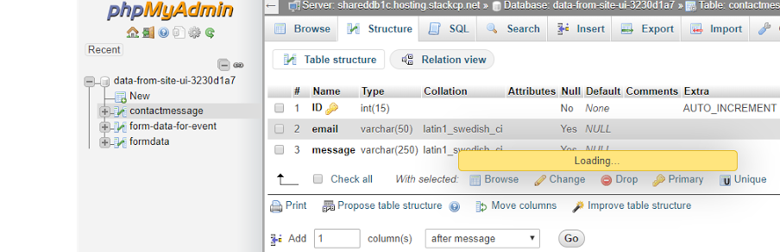
DATABASE
MYSQL, connected using PHP.

Slide 10

RESPONSIVENESS
This feature of our product allows the website to be viewed on many devices without compromising with the quality .

Slide 11
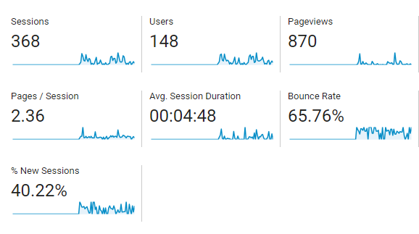
How did we perform?
Let’s see some stats!

Slide 12
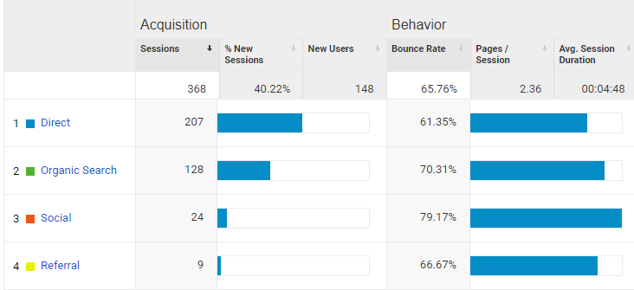

Slide 13
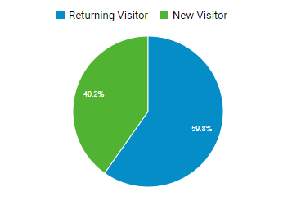
VISITORS

Slide 14
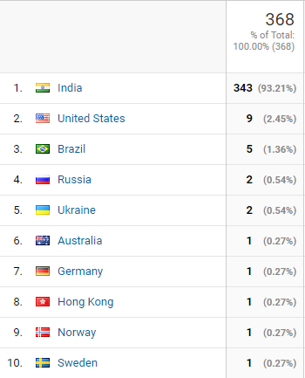
Visits according to countries

Slide 15
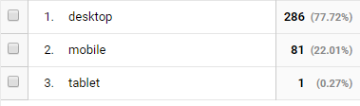
According to platform

Slide 16
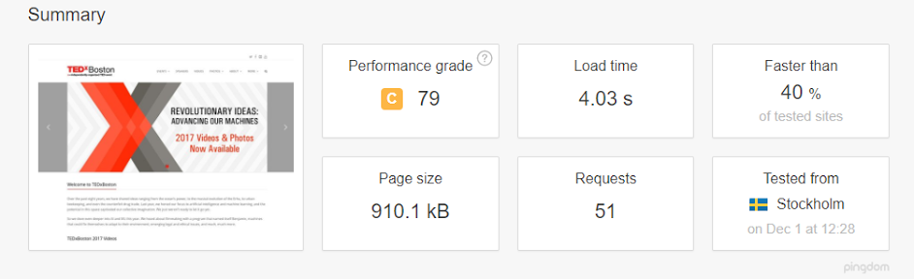
SPEED TEST of TEDxBOSTON

Slide 17
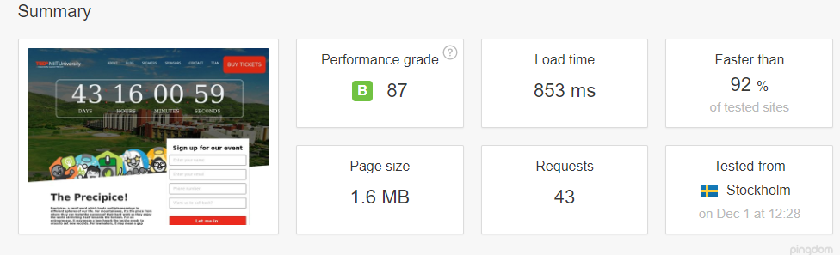
SPEED TEST of TEDx NIITUNIVERSITY

Slide 18
FEEDBACK

Slide 19
What’s NEXT !?
TEDx ROHINI

Slide 20
Questions?
Thank you!

